Slide 1
How to make numbers tell a story
By. Mohamed Essam

Slide 2
What Data Science is ?

Slide 3

What Data Science is ?

Slide 4


Slide 5

When you combine computer science and statistics

Slide 6
What Data Science is ?
Data science is the field of applying advanced analytics techniques and scientific principles to extract valuable information from data for business decision-making, strategic planning and other uses. It's increasingly critical to businesses: The insights that data science generates help organizations increase operational efficiency, identify new business opportunities and improve marketing and sales programs, among other benefits. Ultimately, they can lead to competitive advantages over business rivals.

Slide 7
Why is data science important?
Data science plays an important role in virtually all aspects of business operations and strategies. For example, it provides information about customers that helps companies create stronger marketing campaigns and targeted advertising to increase product sales. It aids in managing financial risks

Slide 8
What Data Science is ?
Data science incorporates various disciplines -- for example, data engineering, data preparation, data mining, predictive analytics, machine learning and data visualization, as well as statistics, mathematics and software programming.

Slide 9

What Data Science is ?

Slide 10
Data science vs Data Analytics
While Data Science focuses on finding meaningful correlations between large datasets, Data Analytics is designed to uncover the specifics of extracted insights.

Slide 11
Data science vs Data Analytics
A Data Analyst role is better suited for those who want to start their career in analytics. A Data Scientist role is recommended for those who want to create advanced machine learning models and use deep learning techniques to ease human tasks

Slide 12
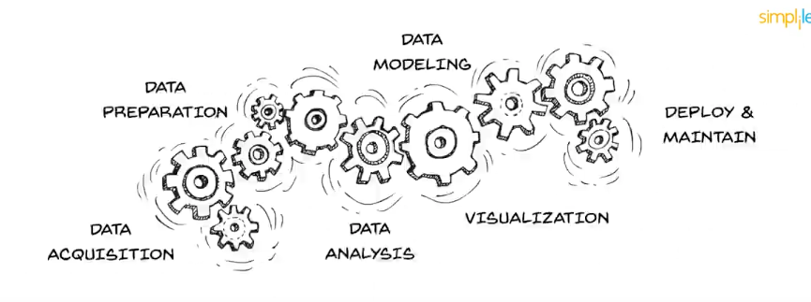
Data science vs Data Analytics
A Data Analyst role is better suited for those who want to start their career in analytics. A Data Scientist role is recommended for those who want to create advanced machine learning models and use deep learning techniques to ease human tasks

Slide 13
Data science vs Data Analytics
BUSINESS PROBLEM.
DATA AQUISTION.
DATA PREPERATION.
EXPLORATORY DATA ANALYSIS(“SELECT THE FEATURES”.
DATA MODELLING.
VISUALIZING AND COMMUNICATION.
DEPLOYMENT.

Slide 14
!
Any Questions?
Mohamed Essam

Slide 15
THANKS!
Contacts
Mhmd96.essam@gmail.com
Please keep this slide for attribution

